Slide 1
Biblical Integration
Jeremy M. Kimble, PhD
Assistant Professor of Theological Studies
Interim Director of the Center for Biblical Integration
Notes:
Share about my first year, learning to do integration effectively. This is a session to help you think about the foundational elements of integration, details regarding your tenure (and non-tenure) and your integration paper, and finally discussion with colleagues and together to generate ideas for integration in your papers and the classroom (assignments, key lectures).

Slide 2
The Center of Biblical Integration at Cedarville University promotes biblical integration throughout curriculum, teaching, and research for both the University and the evangelical community. The center strives to be a resource for integrative study, teaching, and service in drawing connections between a biblical and theological foundation, academic disciplines, and topics of life. The center also aids faculty members in their personal integration efforts in their classrooms, academic research, or professional field.
  Website: https://www.cedarville.edu/Academic-Schools-and-Departments/Center-for-Biblical-Integration.aspx
Notes:
Cedarville University’s Center for Biblical Integration promotes biblical-theological integration across all disciplines, rooted in Scripture, aimed at the glory of God. In this way, the Center intends to engage both the University and the wider evangelical community in sustained reflection upon biblical interpretation, theological synthesis, and worldview analysis. This is done for the sake of producing teaching and research that engages students and scholars in the enterprise of fulfilling their calling to a specific discipline in a distinctly Christian manner. We offer two annual lectureships and training sessions in August and May, as well as individual assistance.

Slide 3
Foundational Truths
The gospel is news, specifically good news about the person and work of Jesus Christ (1 Cor. 15:1-58).
  The gospel is the announcement that the crucified and risen Jesus (perfect Son of God, Son of Man), who died for our sins and rose again according to the Scriptures, has been enthroned as the true Lord and Savior of the world. When this gospel is preached, God calls people, out of sheer grace, to respond in repentance and faith in Jesus Christ.
    This definition is historical, telling us the reality of who Jesus is and what he accomplished.
    It is also experiential, meaning it is applied to us through the means of repentance (turning from sin) and faith in Jesus as our Lord,
    Savior, and Treasure.
Notes:
Gospel, Bible, Theology, Worldview, Academic Disciplines. Then paper details.

Slide 4
Foundational Truths
Biblical integration is the understanding and application of biblical-theological truth to the various spheres of life and academic study.
Scripture is inspired (2 Tim. 3:16-17; 2 Peter 1:20-21), inerrant, infallible, authoritative, clear, and sufficient.

Slide 5
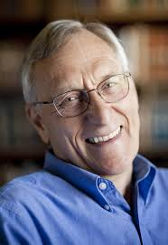
Foundational Truths
Theology, according to David Wells, is the sustained effort to know the character, acts, and will of the triune God as He has disclosed and interpreted these for His people in Scripture, in order that we might know Him, learn to think our thoughts after Him, live our lives in His world on His terms, and by thought and action communicate and live out His truth in our own time and culture.

Slide 6
Importance of Theology
With this definition of theology in mind, if we are to apply Scripture correctly, we must
  Interpret it correctly
  Unpack the biblical storyline, noting how God’s plan unfolds, centered in Christ
  Identify the framework and main themes of the Bible

Slide 7
Importance of Theology
Theology inevitably involves theological construction and doctrinal formulation, grounded in biblical theology and done in light of historical theology, but which also involves interacting with all areas of life—history, science, psychology, ethics, etc.
In so doing, theology leads to worldview formation as we seek to set the biblical-theological framework of Scripture over against all other worldviews and learn “to think God’s thoughts after him,” even in areas that the Bible does not directly address. In this important way, systematic theology presents a well thought out worldview, over against all of its competitors, as it seeks to apply truth to every
domain of our existence.
Notes:
Wellum and Gentry, Kingdom Through Covenant, 35. For first part of sentence, talk about exegesis, BT, HT, ST, PT. A correct approach to Scripture and theology leads us to understand, embrace, and embody the interpretive perspective of the biblical authors.

Slide 8

Notes:
Some may argue this guy is blind, but I think you get the point. As a Christian we understand this guys is seeing the world as it was meant to be seen, through the lens of Scripture.

Slide 9
Philosophy of Integration
Academic Disciplines
Worldview/Wisdom
Bible
Theology
Notes:
Important to note, in third category I would also include ethics, history, literature, and philosophy.

Slide 10
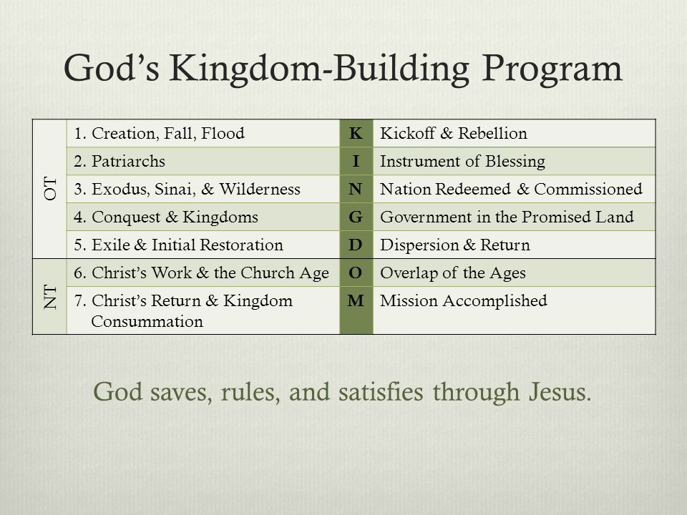
Biblical Storyline
Notes:
Do not just put this in your paper, this is a resource, but look to synthesize.
Summary of the Bible’s storyline.
You could also think of the Bible as drama:
Act 1- God Establishes His Kingdom (creation)
Act 2- Rebellion in the Kingdom (fall)
Act 3- The King Chooses Israel (redemption initiated)
Act 4- The Coming of the King (redemption accomplished)
Act 5- Spreading the News of the King (mission of the church)
Act 6- The Return of the King (redemption completed)

Slide 11
Bible: Framework
God
God is the main character of the Bible.
Covenant
God is relating to His people through covenants.
Christ
The covenants all culminate in Jesus Christ.
Kingdom
Glory
God is glorious and is displaying His glory to the universe.
God is establishing a kingdom.
Notes:
God, glory (theology proper, bibliology), kingdom (anthropology, hamartiology, eschatology), covenant (soteriology, pneumatology, ecclesiology), Christ (Christology).

Slide 12
Bible: Themes
As one goes through the Scriptures certain themes become prominent. These themes form the basis of our theology and serve as the basis for the “language” we speak.
Notes:
Every discipline has a language, we must use it to operate within it. Theology is the foundational language for all of life.

Slide 13
Theology: Biblical-Theological Language
Epistemology (God has revealed Himself, and we can truly know facts about Him and His creation [though not exhaustively]; general and special revelation)
Scripture (inspiration, inerrancy, infallibility, authority, clarity, sufficiency)
God (Trinity, incommunicable and communicable attributes)
Man (made in God’s image, pinnacle of creation)
Sin (any failure to conform to the moral law of God in act, attitude, or nature; ethics)
Notes:
Every discipline has vocabulary, so does theology. Your paper will mainly focus on these areas.

Slide 14
Theology: Biblical-Theological Language
Christ (God-man, Son, second person of Trinity; perfect life, atoning death, resurrection, return)
Salvation (calling, conversion [faith/repentance], justification, adoption, sanctification, glorification)
Spirit (third person of Trinity; convicts of sin, glorifies Christ, indwells, empowers, gifts)
Church (people of God, body of Christ, temple of the Spirit, universal and local, outpost of the kingdom of God, need to belong as member, ministry and mission)
Last things (kingdom of God, already/not yet, Jesus’ return, eternal judgment and salvation)

Slide 15
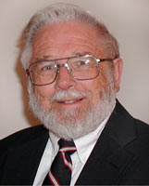
Worldview
A worldview is a commitment, a fundamental orientation of the heart, expressed as a set of presuppositions which we hold about the basic constitution of reality.
  James Sire, The Universe Next Door
Notes:
J. P. Moreland (2001): “A worldview is a set of presupposed beliefs a person accepts, most importantly, beliefs about reality, knowledge, and value.”
What other worldviews are there: atheism, secular humanism, nihilism, deism, theism, pantheism, panentheism, polytheism, mysticism, Islam, Hinduism, relativism, etc.

Slide 16
Worldview
A worldview seeks to answer the following questions:
  Who am I?
  Why am I here?
  What is my purpose?
  What is wrong with the world?
  What is the solution?
  How do I determine what is right and wrong?
  Where is this world going?
  How will it all end?
Notes:
See Christ and Chaos by Dan Dewitt.

Slide 17
Worldview
The grid to answering these questions comes from the storyline and framework of Scripture, and the truths ascertained in theological inquiry.

Slide 18
Ethics
Derived from proper biblical interpretation, theological inquiry, and worldview analysis, we then see the world through a particular ethical lens.
  Character (virtue ethic; 2 Peter 1:3-11)
  Conduct (deontological ethic; Ex. 20:1-17; Eph. 4:17-5:14; Col. 3:1-16)
  Goals (teleological ethic; 1 Cor. 10:31; Col. 3:17)
  Discernment (living a life in line with God’s purposes; Phil. 1:9-11; Eph. 5:15-17; Col. 1:9-10)
Notes:
In all of our fields we will have to teach our students about character and the stands we must take ethically. These four categories could also serve as a broader of integration.

Slide 19
Summary
Christianity is the only worldview that provides an objective foundation for human flourishing. This affects how we articulate a Christian view of the academic disciplines.
Notes:
Outside of Christianity, every other worldview eventually leads to nihilism.

Slide 20
Integration in General
Goal- all for God’s glory
Quality- do what you do with excellence
Service- count others more significant, seek to serve
Honesty- do what you do with integrity
Thankfulness- a spirit of thankfulness should permeate your tasks
Notes:
https://www.desiringgod.org/interviews/how-to-climb-the-corporate-ladder-for-jesuss-sake

Slide 21
Integration in General
Humility- think of yourself less, others-centered, Christ-exalting
Joy- rejoice in the Lord always, including work
Not murmuring- no grumbling or disputing (Phil. 2:14-15)
Patience- have a self-controlled spirit
Aware- God is Creator and Sustainer of
all we do in every discipline

Slide 22
Specific Integration: Scholarly Disciplines
How do my Christian beliefs affect my approach to my academic discipline or professional field?
Does the Bible address my discipline directly and specifically? If not, how does theology shape your interpretation of findings in your field?
Do I teach my students to think/write/compose/act within my field or discipline as a believer?
Am I pointing out to students things within our discipline that are not biblical and must be rejected? Affirmed? Redeemed? (This is an important component of the second section of your integration paper).
Do I take a holistic approach to instructing my audience (students or peers), promoting character development (i.e. spiritual growth)?
In what specific ways do you hope to bring glory to God in
your work?

Slide 23
Scholarly Disciplines
True biblical integration for a specific discipline requires biblical investigation and interpretation, as well as theological synthesis. It is the theology (drawn from rigorous biblical interpretation) that becomes the means for engaging all disciplines and fields.
True biblical integration means that we are called to love our neighbors as ourselves, know what can be affirmed, rejected, and redeemed in our disciplines based on that biblical-theological foundation, and allow your biblical-theological
worldview to shape your interpretation of findings
in your field.
Notes:
They need to spell these first two points out in detail. They need to show theological astuteness and awareness of their fields.

Slide 24
Scholarly Disciplines
The scholar (or student) with a biblical-theological mindset can pursue and communicate wisdom in predominately “secular” academic fields. This pursuit and communication requires penetrating the citadel of contemporary “knowledge” and brings every thought captive in service to others and for the sake of God’s glory (cf. 2 Cor. 10:3-5).

Slide 25
Integration Paper
Five main points of your paper:
  The faculty member's Christian worldview (e.g., beliefs concerning God, creation, man, sin, epistemology, etc.).
  The correlation between Scripture or scriptural principles and his or her discipline.
  The faculty member's role in and commitment to Christian higher education.
  The relationship between faith and practice as demonstrated in teaching philosophy and lifestyle.
  The methods and means for communicating these beliefs in the classroom.
Notes:
These are the core components of your integration paper (https://www.cedarville.edu/Faculty-Staff/Faculty-Handbook/Chapter-3/Faculty-Evaluation-Policy/Integration-Statement-Criteria.aspx).
As appropriate, the faculty member should present evidence of integration concepts that have been incorporated into course syllabi, lectures, and assignments, along with comments from students, peers, and the department chair.

Slide 26
Integration Paper
Content: it is a statement of personal worldview and biblical integration within one’s discipline.
  BIP is not to be a generic statement about integration in general.
  Clearly support your views on the five criteria spelled out in the FHB (label these five criteria, provide sub-headings as appropriate).
  Application of a biblical worldview to a discipline may include examples of what can be affirmed, rejected, or redeemed, but does not have to include all three.
  Scripture should not be quoted at length, but note the references throughout for support (objective is to write what you believe with Scriptural support rather than to quote verse after verse without getting to what you believe).
Notes:
BIP Didactic (https://www.cedarville.edu/cf/avp/documents/index.cfm?event=Main&path=Special.Files.1603__Integration_Paper_Didactic__1.pdf&showfile=1)

Slide 27
Integration Paper
Format: resulting BIP should be of publishable quality in every aspect
  Font: for text, use Times New Roman, Cambria (Body) or Arial, 12 point. Use same font and size throughout.
  Margins: use 1-inch on both sides, top, and bottom.
  Length: 10-40 content pages (double-spaced).
  Style guide: Chicago Manual or APA.
  While the BIP is not a research paper, it needs to interact with current literature (use 10-20 properly footnoted sources, not counting Scripture references).
  Include a title page, and number all subsequent pages.
BOTTOM LINE: use the BIP to clearly articulate your worldview and
biblical application to your discipline. It will inform CU leaders as
they consider your future at Cedarville.

Slide 28
Questions
Paper
  What are examples in your field, based on theological truth, of what you affirm, reject, and redeem?
  How do biblical-theological truths shape your interpretation and conclusions in your field?
Classroom
  What assignments do you use for integration?
  What lectures or classroom activities do you use
  to promote integration?

