Slide 1
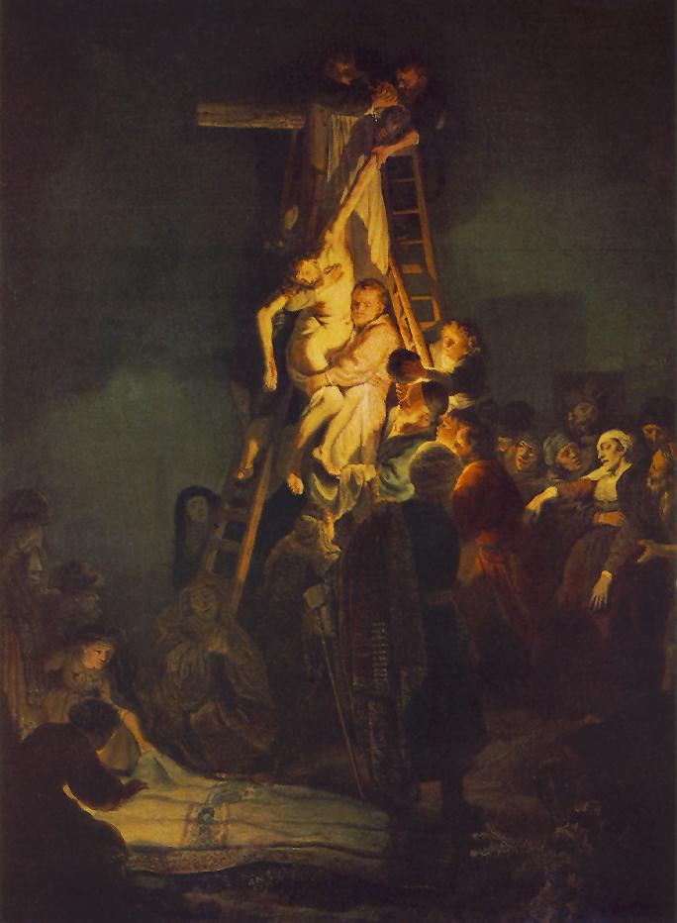
Salvation
Christ’s Righteousness Saves Us From The Wrath of God

Slide 2
Luther on the Justifying Union with Christ
In his comments on Galatians 2, Luther states:
“Faith takes hold of Christ and has Him present, enclosing Him as the ring encloses the gem. And whoever is found having this faith in Christ who is grasped in the heart, him God accounts as righteous. This is the means and the merit by which we obtain the forgiveness of sins and righteousness. ‘Because you believe in Me,’ God says, ‘and your faith takes hold of Christ, whom I have freely given to you as your Justifier and Savior, therefore be righteous.’ Thus God accepts you or accounts you righteous only on account of Christ, in whom you believe.” (LW 26:132)

Slide 3
Two Cautions for Theological Discourse
Often the trajectory in theological discourse (popular and scholarly) is from general affirmations (often with broader agreements) to specific positions on one element of a larger doctrine. This narrowed focus is appropriate and can be driven by dogmatic or academic interests. Drawing on a broader sample of confessional positions (historical and contemporary) and scholarly discourse can provide some needed perspective and hopefully, some charity.
(Examples on the doctrine of salvation: Lutheran research on the Formula of Concord and the “antinomian” label, Reformed- Arminian discussions of the Synod of Dort and the development of the “TULIP”, or Charles Finney’s aversion to imputed righteousness as espoused by First Great Awakening leaders.)
The use of Scripture in these theological discourses can minimize the textual context for the sake using a text in a systematic (theological) manner. This type of usage is needed in systematic discussions and should proceed with caution and the realization that attention to the book-level meaning of a text (within its canonical context) is the most fitting reading (interpretative) strategy for biblical texts.

Slide 4
A couple comments on method and context
Method- This presentation attempts to model the approach described by Dr. Kimble (theological method) and Dr. Spellman (Hermeneutics) last semester. This method acknowledges the canonical context of biblical texts and recognizes the authority of the textual revelation (Kira) even as it draws on historical sources and systematic vocabulary.
Context- This presentation attempts to describe some aspects of the doctrine of salvation within a particular confessional context (CU, as outlined by Dr. White last semester) and builds on previous presentations by Gilhooly (God), Marsh (Humanity and Sin), and most closely with Moore (Christology) while anticipating upcoming presentations on the church (White), the Spirit (Bowden), and last things (Kimble). The doctrine of salvation has touch points with all other major systematic categories.

Slide 5
Cedarville University “Doctrinal Statement”
Article 5- We believe that the Lord Jesus Christ died for our sins according to the Scriptures as the representative and substitutionary sacrifice and rose again for our justification. Only those who repent and believe in Him are justified on the grounds of His shed blood and are saved by grace through faith wholly apart from human merit and works. Genuine believers, the elect, are the adopted children of God and are eternally secure through the work of God. John 1:12,13; 3:3-16; 5:24; 10:28,29; Acts 13:39; 16:31; Romans 3:21-28; Ephesians 1:3-14; 2:8-10; Philippians 1:6; Titus 3:3-8; 1 Peter 1:23; 2 Peter 1:4-11.
Notice in keeping with the cautions on the previous slide, CU’s statement on salvation avoids the extremes of “hyper-Calvinism” and “semi-Pelagianism” and anticipates charity from various positions along the sliding scale of the “five points”.

Slide 6
Salvation (various aspects)
From:
Our sin (personal)
The wrath of God (corporate)
By:
Grace through faith
The work of the Holy Spirit
To:
Abundant life (now), a life of maturity in a new family
Eternal life (New heavens/ earth)
For:
New humanity
The glory of God
On account of:
His promises (the gospel)
His purposes (election)
In:
Christ

Slide 7
Salvation and the Need for Righteousness
Since Genesis 3, the lack of righteousness has plagued humanity. In the Law, righteousness is presented as a “declaration” of status by God. Notice in Genesis 15:6 that because Abram believed a specific promise(s) of God about an heir (seed- v.4) God credited it to him as righteousness.
Also, Deuteronomy 6:24-25 and Psalm 112:7-9 continue the twin themes of faith (in God’s promised deliverance) and fear (of His greatness/ judgment). These affirmations will be “our righteousness” (Dt 6:25). God reveals His righteousness in His salvation of His people (Ps 98).
For a sinful people, repentance leads to the righteousness (Is 1:27) that will characterize the rule of the Son of David (Is 11 and 16). The needed righteousness of the kingdom will only be available to those who seek it (Is 51, Jer 23, Zech 8, and Matt 6) from the Lord Himself, whose righteous reign will be the salvation of His people (Is 52, 56, and Matt 6).

Slide 8
Salvation and the Need for Righteousness
How can a sinful humanity be made or declared righteous in order to participate forever in the people of God?
The church has grappled with this question and how to provide a clear answer for almost two thousand years.
Often the church has turned to the writings of the apostles (in the NT), especially Paul, and the phrase to be “justified by faith”. This confession is that through faith in Christ a believer receives righteousness from God as a result of the union with Christ.

Slide 9
Relevant Biblical Texts
A small sampling…

Slide 10
1 Corinthians 1:28–31
[28] God chose what is low and despised in the world, even things that are not, to bring to nothing things that are, [29] so that no human being might boast in the presence of God. [30] And because of him you are in Christ Jesus, who became to us wisdom from God, righteousness and sanctification and redemption, [31] so that, as it is written, “Let the one who boasts, boast in the Lord.” (ESV)

Slide 11
2 Corinthians 5:17-18, 21
[17] Therefore, if anyone is in Christ, he is a new creation. The old has passed away; behold, the new has come. [18] All this is from God, who through Christ reconciled us to himself and gave us the ministry of reconciliation;
[21] For our sake he made him to be sin who knew no sin, so that in him we might become the righteousness of God. (ESV)

Slide 12
Relevant Historical Texts
A small sampling…

Slide 13
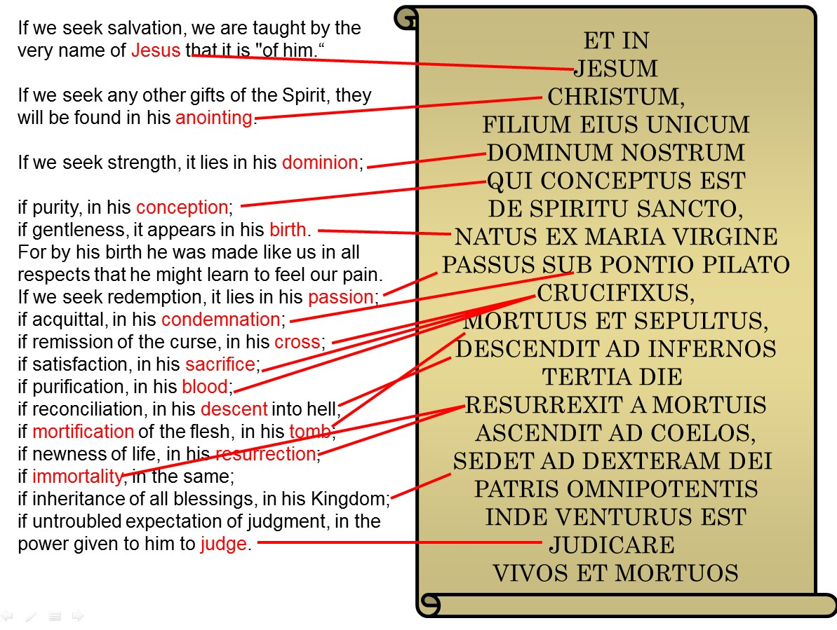
The Apostles’ Creed and Calvin’s Institutes (2.16.19)
Fred Sanders notes that Michael Horton et al have noted how Calvin draws on the Apostles’ Creed to demonstrate how our salvation is “in Christ” or on the basis of our union with him. Sanders extends this idea by drawing verbal parallels between Calvin (the Institutes in Latin) and the Creed.
Source: Fred Sanders, web publication

Slide 14
St. Augustine (418)
When, indeed, it has been given, it is not called our own righteousness, but God’s; because it becomes our own only so that we have it from God. These are the apostle’s words: “That I may be found in Him, not having mine own righteousness which is of the law, but that which is through the faith of Christ the righteousness which is of God by faith.”(Philippians 3:8-9) So great, then, is the difference between the law and grace, that although the law is undoubtedly of God, yet the righteousness which is “of the law” is not “of God,” but the righteousness which is consummated by grace is “of God.” The one is designated “the righteousness of the law,” because it is done through fear of the curse of the law; while the other is called “the righteousness of God,” because it is bestowed through the beneficence of His grace. (A Treatise on the Grace of Christ and Original Sin, chap.14)

Slide 15
Philippians 3:7–11 (from Augustine’s citation)
[7] But whatever gain I had, I counted as loss for the sake of Christ. [8] Indeed, I count everything as loss because of the surpassing worth of knowing Christ Jesus my Lord. For his sake I have suffered the loss of all things and count them as rubbish, in order that I may gain Christ [9] and be found in him, not having a righteousness of my own that comes from the law, but that which comes through faith in Christ, the righteousness from God that depends on faith—[10] that I may know him and the power of his resurrection, and may share his sufferings, becoming like him in his death, [11] that by any means possible I may attain the resurrection from the dead. (ESV)

Slide 16
Augsburg Confession (1530)
Art. IV- De Justificatione. | Article 4- Of Justification.
Item docent, quod homines non possint justificari [Vergebung der sünde und Gerechtigkeit erlangen] coram Deo propriis viribus, meritis aut operibus, sed gratis [aus Gnaden] justificentur propter Christum per fidem, cum credunt se in gratiam recipi, et peccata remitti propter Christum, qui sua morte pro nostris peccatis satisfecit. Hanc fidem imputat Deus pro justicia coram ipso. Rom. III. et IV.⁸ | Also they teach that men cannot be justified [obtain forgiveness of sins and righteousness] before God by their own powers, merits, or works; but are justified freely [of grace] for Christ's sake through faith, when they believe that they are received into favor, and their sins forgiven for Christ's sake, who by his death has satisfied for our sins. This faith God imputes for righteousness before him (Romans 3 and 4).

Slide 17
Second Helvetic Confession (1566)
Chap. XV. Of True Justification of Believers. -- 'To justify' means, with the Apostle when treating of this subject, to remit sins, to absolve from guilt and punishment, to receive into grace, and to pronounce just (Rom. 8:33; Acts 8:38; Deut. 25:1; Isa. 5:23).
By nature we are all sinners and guilty of death before the tribunal of God, and we can be justified only by the merits of Christ crucified and risen again. For his sake God is reconciled, and imputes to us not our sins, but the righteousness of Christ as our own, so that we are purged and absolved from sin, death and damnation, and heirs of eternal life. Properly speaking, God alone justifies and justifies only for Christ's sake, not imputing to us our sins, but the righteousness of Christ.
We therefore teach and believe, with the Apostle, that the sinner is justified by faith alone in Christ (sola fide in Christum), not by the law, nor by any works (Rom. 3:28; 4:2; Eph. 2:8-9). Righteousness is imputed to faith because it receives Christ as our righteousness and ascribes all to the grace of God, but not because it is our work: it is the gift of God. As we receive food by eating, so faith appropriates Christ.
We do not divide justification by ascribing it partly to the grace of God or to Christ, and partly to our works or merits, but solely and exclusively to the grace of God in Christ through faith. We must first be justified before we can do good works. Love is derived from faith (1 Tim. 1:5; Gal. 5:6).
Therefore we speak here not of a false, dead faith, but of a living and vivifying faith which lives in Christ, our life, and proves its life by living works. Even James (chap. 2) does not contradict our doctrine, for he speaks of a dead faith which even demons have, and he shows that Abraham proved his living and justifying faith by works.

Slide 18
Romans 3:21-26 (referenced in Augsburg and 2nd Helvetic)
21 But now the righteousness of God has been manifested apart from the law, although the Law and the Prophets bear witness to it— 22 the righteousness of God through faith in Jesus Christ for all who believe. For there is no distinction: 23 for all have sinned and fall short of the glory of God, 24 and are justified by his grace as a gift, through the redemption that is in Christ Jesus, 25 whom God put forward as a propitiation by his blood, to be received by faith. This was to show God’s righteousness, because in his divine forbearance he had passed over former sins. 26 It was to show his righteousness at the present time, so that he might be just and the justifier of the one who has faith in Jesus. (ESV)

Slide 19
Relevant Contemporary Theological Discussion
A small sampling…

Slide 20
Righteousness by faith in Christ
Besides Romans 3, perhaps the key text in this idea of justification by faith in Christ is Galatians 2. This text (along with Rom 3) connects faith, righteousness, and Christ with the self-declared sinner.
Galatians 2:16
But we know that God accepts only those who have faith in Jesus Christ. No one can please God by simply obeying the Law. So we put our faith in Christ Jesus, and God accepted us because of our faith. (CEV)

Slide 21
Galatians 2:15–21
[15] We ourselves are Jews by birth and not Gentile sinners; [16] yet we know that a person is not justified by works of the law but through faith in Jesus Christ, so we also have believed in Christ Jesus, in order to be justified by faith in Christ and not by works of the law, because by works of the law no one will be justified.
[17] But if, in our endeavor to be justified in Christ, we too were found to be sinners, is Christ then a servant of sin? Certainly not! [18] For if I rebuild what I tore down, I prove myself to be a transgressor. [19] For through the law I died to the law, so that I might live to God. [20] I have been crucified with Christ. It is no longer I who live, but Christ who lives in me. And the life I now live in the flesh I live by faith in the Son of God, who loved me and gave himself for me. [21] I do not nullify the grace of God, for if righteousness were through the law, then Christ died for no purpose. (ESV)
Some translations read “by the faithfulness of Christ” (NET) or offer this reading as an option (CSB).

Slide 22
Galatians 2:15–21 (SBL 2010 text)
V.16- εἰδότες δὲ ὅτι οὐ δικαιοῦται ἄνθρωπος ἐξ ἔργων νόμου ἐὰν μὴ διὰ πίστεως Ἰησοῦ Χριστοῦ, καὶ ἡμεῖς εἰς Χριστὸν Ἰησοῦν ἐπιστεύσαμεν, ἵνα δικαιωθῶμεν ἐκ πίστεως Χριστοῦ καὶ οὐκ ἐξ ἔργων νόμου, ὅτι ἐξ ἔργων νόμου οὐ δικαιωθήσεται πᾶσα σάρξ.
V.17- εἰ δὲ ζητοῦντες δικαιωθῆναι ἐν Χριστῷ εὑρέθημεν καὶ αὐτοὶ ἁμαρτωλοί, ἆρα Χριστὸς ἁμαρτίας διάκονος; μὴ γένοιτο·
V. 20- ζῶ δὲ οὐκέτι ἐγώ, ζῇ δὲ ἐν ἐμοὶ Χριστός· ὃ δὲ νῦν ζῶ ἐν σαρκί, ἐν πίστει ζῶ τῇ τοῦ υἱοῦ τοῦ θεοῦ τοῦ ἀγαπήσαντός με καὶ παραδόντος ἑαυτὸν ὑπὲρ ἐμοῦ.
How should the genitive in Ἰησοῦ Χριστοῦ be read? Is it objective or subjective? Can it indicate a possessive?
Should the “ἐν Χριστῷ” be taken instrumentally? Is the translation “in Christ” to be preferred to “by Christ”?
See the following discussion about the phrase ἐν ἐμοὶ.

Slide 23
Seifrid on Luther’s Justifying Union with Christ
In his contribution to the contemporary debate on union with Christ in Gal 2, Mark Seifrid comments:
“Consequently, Luther speaks of union with Christ in terms of union with Christ in his saving work. At least in the first instance, the significance of the relation lies not in the work for which Christ frees us, but in our continuing participation in the work that already has been accomplished.” (Seifrid, WTJ, 224)
“It is at this critical point that Luther's conception of a justifying union with Christ differs most significantly from that of Osiander. The latter treats the work of redemption as an event of the past that serves as a prelude, albeit a necessary one, to a union that justifies on account of the "essential" deity of Christ. Luther, in contrast, understands our union with Christ as a union with him in his saving work. With Luther it is not only that Christ's humanity is included within the scope of the union, but that it is included concretely in the history of his incarnation, cross, and resurrection.” (Seifrid, WTJ, 226)

Slide 24
Expositor’s Biblical Commentary- J.M. Boice
“ ‘Justify’… is a forensic term borrowed from the law courts. It means “to declare righteous or innocent.” The opposite of ‘to justify’ is ‘to condemn’ or “to pronounce guilty.” Such a term involves an objective standard, and since righteousness is understood to be the unique characteristic of God, that standard must be the divine standard. In themselves, all persons fall short of this standard– ‘For all have sinned and fall short of the glory of God’ (Rom 3:23). But in Christ, God declares all righteous who believe, imputing divine righteousness to them. In this sense, justification does not express an ethical change or influence (though ethical changes follow); rather, it expresses the judicial action of God apart from human merit according to which the guilty are pardoned, acquitted, and then reinstated as God’s children and as fellow heirs with Jesus Christ.” (p. 448-9)

Slide 25
Expositor’s Biblical Commentary- J.M. Boice
“This experience does not happen automatically to all men. It is true that God justifies, but he does so only as he unites a man or woman to Christ, a union that takes place only through the channel of human faith. Faith is the means, not the source, of justification. Faith is trust. It begins with knowledge, so it is not blind. It builds on facts, so it is not speculation. It stakes its life on the outcome, so it is not impractical. Faith is trusting Christ and proving his promises. The expression in the middle of v. 16, literally “we have believed into Christ,” implies an act of personal commitment, not just assenting to the facts concerning Christ, but actually running to him for refuge and seeking mercy…. The threefold repetition of the doctrine of justification by faith in this one verse is important, because it shows the importance the apostle gives to the doctrine.” (p. 449)

Slide 26
Expositor’s Biblical Commentary- J.M. Boice
“What does it mean to be ‘in Christ’? It means to be so united to Christ that all the experiences of Christ become the Christian’s experiences. Thus, his death for sin was the believer’s death; his resurrection was (in one sense) the believer’s resurrection; his ascension was the believer’s ascension, so that the believer is (again in one sense) seated with Christ ‘in the heavenly realms’ (so Eph 2:6). This thought is particularly evident in Paul’s use of the perfect tense in speaking of his having been crucified with Christ.” (p.451)

Slide 27
F.F. Bruce on the Resurrected Life
In commenting on 2:20, F.F. Bruce writes, “Having died with Christ in his death, the believer now lives with Christ in his life– i.e. his resurrection life. In fact, this new life in Christ is nothing less than the risen Christ living his life in the believer. The risen Christ is operative power in the new order, as sin was in the old.” (Bruce, NIGTC, 144)
In his master’s thesis, interacting with Bruce’s work, Greg Couser summarizes this section of Galatians,
“In the closing verses of chapter 2, Paul explicates the gospel, viz. Jew and Gentile are justified by faith apart from works of the law, which the Galatians were in danger of abandoning for slavery (2:15-21).” (Couser, 61)

Slide 28
Baker’s Evangelical Dictionary of Biblical Theology
Paul uses the phrase (“in Christ”) to describe a mode of existence in which the believer identifies with the death and resurrection of Christ (Rom 6:11); shares in his wisdom and holiness (1 Cor 1:30); and receives a new life or existence (2 Cor 5:17). This is expressed in the epistle to the Colossians by relating the theme of Christ's "fullness" to the believer's position "in him" (2:8-15). In Christ, who is the "fullness of the Deity" (v. 9), believers "have been given fullness" (v. 10). They have been circumcised by the "circumcision done by Christ" (v. 11), "buried with him in baptism, " and "raised with him through faith" (v. 12). Faith-union with Christ, therefore, makes possible incorporation into a new sphere of existence marked by "fullness, " covenant relation, and resurrection life.
For the apostle, to be "in Christ" is the same as having "Christ in me" (Gal 2:19-20). In fact, the message of "Christ in you" is the revelation of God's "mystery" and the "hope of glory" for believers (Col 1:27). Through faith and love the believer is united with his Lord. Present by his Spirit, Christ indwells believers and makes possible their adoption as sons and daughters of God (Rom 8:14-16; Gal 4:6 ). (R. David Rightmire)

Slide 29
J. Andrew Cowan on the Union with Christ
Similar to D.A. Carson, J.A. Cowan points to union with Christ as central to interpreting several key phrases in Gal. 2.
“(Gal) 2.19-20 is a description of the justifying relationship mentioned in 2.17 because the references to ‘life’ in 2.19-20 metonymically represent a positive verdict in the divine courtroom. Furthermore, it has been proposed that the phrase ‘Christ lives ἐν ἐμοὶ’ should be viewed as a reference to Christ’s resurrection life as a reality into which Paul has been incorporated rather than as a reference to Christ’s presence within Paul by means of the Holy Spirit. Christ’s resurrection life represents his own status as righteous before God, and Paul can speak of this life and status as his because of his union with Christ.” (Cowan, JSNT, 40(4):465)

Slide 30
Finding the Forest in All of these Trees
The biblical presentation of salvation is best discovered in the reading (and re-reading) of the biblical texts. Throughout the whole canon, narrative books will picture God’s saving work in the past in order to stir hope in the climatic salvation in the last days. Further, poetic books in the Bible exemplify people praising God for His great work of salvation and humbling themselves before His righteous judgment.
Salvation is needed by all people (“Jews and Gentiles”) and comes through Christ. This truth prompts the church’s mission of proclaiming the gospel to all nations.
Justification is theological vocabulary for the amazing, gracious work of God where He declares sinners to be righteous because they are united to Christ by faith in Him.
God’s redeemed people share in the “first-fruits” of salvation now (e.g. forgiveness of sin, new life, indwelling of the Spirit, a new family) and long for the fulfillment of God’s saving promises.
And for a pastoral takeaway… or two.

Slide 31
Michael Reeves (Union School of Theology, U.K.)
Q: “Yes, so what happens when a Christian truly comes to grasp union with Christ for the first time?”
A: “I will tell you my own experience. It meant a freedom from a real despair because I was taking this seriously. I couldn’t be sure of how God would look at me until I knew about union with Christ. And it was actually reading Luther’s Freedom of the Christian that convinced me of that and I saw for the first time I can have confidence before God in Christ. And that brought a freedom to be able to call out to God as Abba and that liberated me from a suicidal despair.” (Excerpt from DesiringGod.org, “Interviews”)

Slide 32
Echoes of Luther
Michael Reeves’ statement on the previous slide echoes Luther’s comments on Gal. 2:16:
“A Christian is not someone who has no sin or feels no sin; he is someone to whom, because of his faith in Christ, God does not impute his sin. This doctrine brings firm consolation to troubled consciences amid genuine terrors.” (LW 26:133)

Slide 33
Some Further Resources (a tiny sampling)
Bird, Michael F.
2007 The Saving Righteousness of God: Studies on Paul, Justification, and the New Perspective (Eugene, OR: Wipf& Stock).
Campbell, Constantine R.
2012 Paul and Union with Christ: AnExegetical and Theological Study (Grand Rapids, MI: Zondervan).
Campbell, Douglas A.
2009 The Deliverance of God: An Apocalyptic Rereading of Justification in Paul (Grand Rapids, MI: Eerdmans).
Carson, D.A.
2004 ‘The Vindication of Imputation: On Fields of Discourse and Semantic Fields’, in Mark Husbands and Daniel J. Treier (eds.), Justification: What’s at Stake in the Current Debates? (Downers Grove, IL: IVP): 46-78.
Moo, Douglas J.
2013 Galatians (BECNT; Grand Rapids, MI: Baker).
Schreiner, Thomas R.
2010 Galatians (ZECNT; Grand Rapids, MI: Zondervan).
Seifrid, Mark A.
2003 ‘Paul, Luther, and Justification in Gal 2.15-21’, WTJ 65: 215-30.
*Sources drawn from Cowan’s article in JSNT

