Slide 1
Theology and Worldview
Theology Seminar
Jeremy M. Kimble, PhD
Associate Professor of Theology
Director of the Center for Biblical Integration

Slide 2
Definition of Theology
Anselm defined theology as faith seeking understanding.
William Ames described theology as the teaching of living to God.
Most generally we can say that theology is the study of God and all that pertains to Him.
Notes:
Faith in God revealed in Jesus Christ prompts a questioning search for deeper understanding.
Ames believed theology led to obedience.

Slide 3
Definition of Theology
Another way to say it is that theology is disciplined reflection on God’s self-revelation for the purposes of knowing God, loving God, and being on His mission in His world.

Slide 4
Theology as an Interdependent Study
Exegesis
Biblical Theology
Historical Theology
Systematic Theology
Practical Theology

Slide 5
Theology as an Interdependent Study
Exegesis: careful reading, sound interpretation.
Exegesis answers the questions, “What does this text actually say?” and “What did the author mean by what he said?”
We discover this by careful reading and applying sound principles of interpretation to the Bible.
Good readers pay attention to words and their meanings and to the ways sentences, paragraphs, and longer units are put together. They observe that the Bible is a book that includes many different styles of literature—stories, laws, proverbs, poetry, prophecy, history, parables, letters, apocalyptic, and much more.
Good readers follow the flow of texts and always consider context.

Slide 6
Theology as an Interdependent Study
Biblical Theology: the attempt to understand and embrace the worldview (interpretive perspective) of the biblical authors, and to understand the parts (verses, chapters) in light of the whole (books, Testament, canon).
Thus, the NT use of the OT, and intertextuality are of utmost importance.
Notes:
https://www.zondervan.com/p/biblical-theology/what-is/ Harry Potter and Biblical Theology

Slide 7
Theology as an Interdependent Study
Biblical Theology
The biblical covenants
Adamic Covenant (Gen 1-2; esp. 1:26-31, 2:15-17; cf. Hos. 6:7).
Noahic Covenant (Gen 6-9; esp. 8:20-9:17).
Abrahamic Covenant (Gen 12-17; esp. 12:1-3).
Mosaic Covenant (Ex19-20, Deut 4:1-8; esp. Ex19:19).
Davidic Covenant (2 Sam 7; esp. 7:8-17; also 1 Chr 17).
New Covenant (Deut 30:6-10; Jer 31:31-34; Ezek 36:22-32; Heb 8-10).
Notes:
Talk about God, glory, kingdom, covenants, Christ. God reigns saves and satisfies through covenant for His glory in Christ.

Slide 8
Theology as an Interdependent Study
Biblical Theology
The biblical storyline
Creation
Catastrophe
Covenants
Christ
Church
Consummation
Notes:
Talk about God, glory, kingdom, covenants, Christ. God reigns saves and satisfies through covenant for His glory in Christ.

Slide 9
Theology as an Interdependent Study
Historical Theology: This type of theology looks at the historical development of doctrine
Four key eras of church history:
Patristic (100-500)
Medieval (500-1500)
Reformation (1500-1750)
Modern (1750-present)
Notes:
controversies that have shaped the questions we ask and the answers we get, key historical theologians, and important turning points in church history.

Slide 10
Theology as an Interdependent Study
Systematic Theology: the study that answers the question, “What does the whole Bible teach us today?” about any given topic.
It is thus topical in nature (God, humanity, sin, Christ, Spirit, church, etc.).
Notes:
The attempt to understand and embrace the synthesizing themes spelled out by the biblical authors. Systematic theology leads to worldview formation as we seek to set the biblical-theological framework of Scripture over against all other worldviews and learn “to think God’s thoughts after him,” even in areas that the Bible does not directly address. In this important way, systematic theology presents a well-thought-out worldview, over against all of its competitors, as it seeks to apply biblical truth to every domain of life.
As a discipline it is also critical in seeking to evaluate ideas within and outside the church. Outside the church, systematic theology takes on an apologetic function as it first sets forth the faith to be believed and defended, and then critiques and evaluates views that reject the truth of God’s Word. In this way, apologetics is properly a subset of systematic theology. Within the church, theology is critical by analyzing theological proposals first in terms of their fit with Scripture and secondly in terms of their implications for other doctrines. In all these ways, systematic theology is the discipline which attempts “to bring our entire thought captive to Christ” (see 2 Cor. 10:1–5), for our good as the church and ultimately for God’s glory.

Slide 11
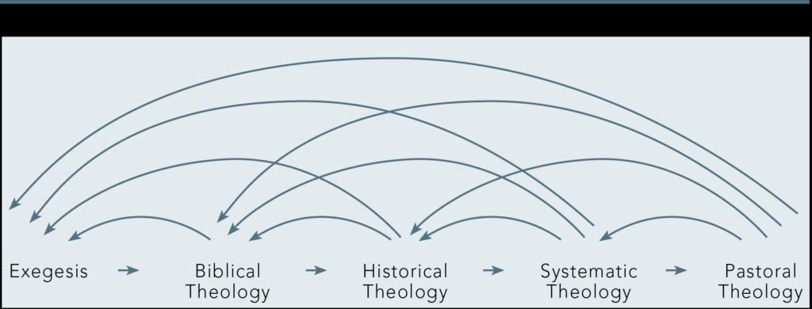
Theology as an Interdependent Study

Slide 12
Importance of Theology
The Bible and theology form the content of our worldview as we seek to set the biblical-theological framework of Scripture over against all other “worldviews” and learn “to think God’s thoughts after him,” even in areas that the Bible does not directly address (presuppositions, findings, conclusions).
In this important way, the Bible and good theology present a well thought out worldview, over against all of its competitors, as it seeks to apply truth to every domain of our existence.

Slide 13
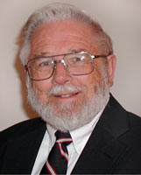
Definition of a Worldview
A worldview is a commitment, a fundamental orientation of the heart, expressed as a set of presuppositions which we hold about the basic constitution of reality.
James Sire, The Universe Next Door
Notes:
J. P. Moreland (2001): “A worldview is a set of presupposed beliefs a person accepts, most importantly, beliefs about reality, knowledge, and value.”
What other worldviews are there: atheism, secular humanism, nihilism, deism, theism, pantheism, panentheism, polytheism, mysticism, Islam, Hinduism, relativism, etc. What kinds of questions does a worldview ask?

Slide 14
Definition of a Worldview
What goes into a worldview?
To summarize, a worldview consists of the story through which people interpret the world (metanarrative), the truths derived from the story (doctrine), the behaviors promoted and discouraged by the story (ethics), the symbols that summarize and interpret the story (imagery, typology, etc.), and the worship and work the story intends to promote (liturgy).

Slide 15
Worldview
A worldview seeks to answer the following questions:
What constitutes reality?
How can we know anything at all?
Who am I?
Why am I here?
What is my purpose?
What is wrong with the world?
What is the solution?
How do I determine what is right and wrong?
Where is this world going?
How will it all end?

Slide 16
The Biblical Worldview
The triune God, Father, Son, and Spirit, has created and revealed Himself to us, human beings, made in His image, but marred by sin and death and under condemnation. However, Christ, the God-man, has made a way of redemption for those who believe in the gospel, by the power of the Spirit, and now calls us to grow in godliness together as a corporate body of believers, awaiting the day of His return where He will glorify Himself in salvation and judgment.
Notes:
This summary is based on the various topics of ST.

Slide 17
Relationship between Theology and Worldview
The answer to worldview questions, the story that undergirds our lives, our ethics, imagery, and source for how and why we worship, come from Scripture.
As we continue in our study of these interconnected disciplines we engage the world in a way that is fitting with the teachings of the Bible, rejecting, receiving, and redeeming presuppositions, findings, and conclusions within our disciplines.

